Slide 1
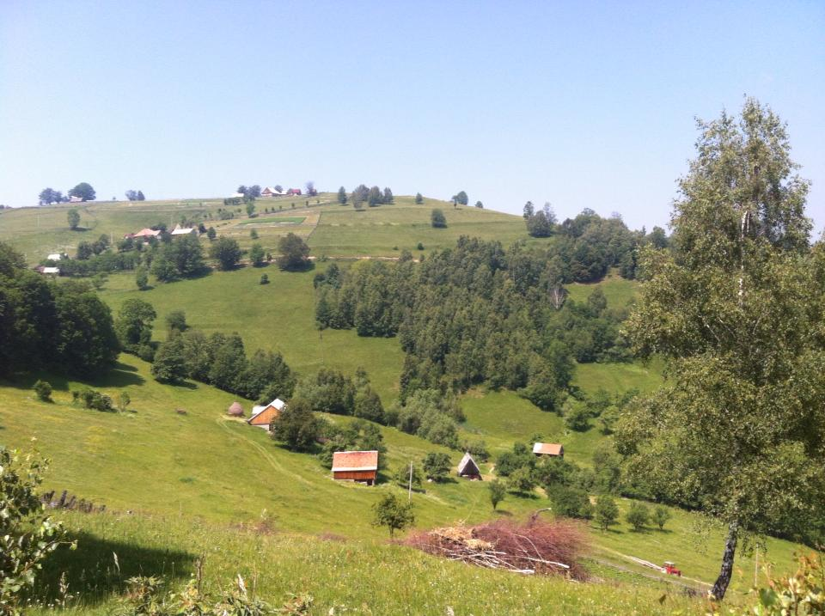
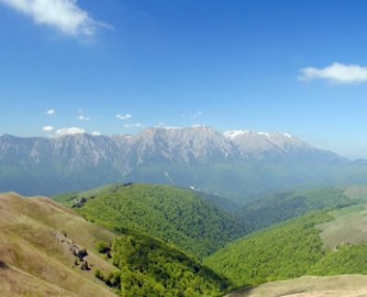
Sibiu Rural Area
R O M A N I A
Cartisoara Village

Slide 2
Sibiu Rural Area - General Information
Inside the Carpatians Arch, 45g47’ lat N, 24g05’ long E;
Total Surface: 5432 km²;
Relief: Hilly and Montan;
Climate: Temperat Continental, vary due to altitude;
Vegetation: silvo-stepa, altitudinal ranged, 60% forests;
Arable areas with black earth, rich in humus, suitable for Eco Agriculture;
Animal Husbandry in mountain areas, based on natural grass lands. Traditional is sheep husbandry;

Slide 3
Sibiu Rural Area - General Information
Accessibility
Airport Sibiu and Targu Mures;
National Highway infrastructure;
Two autoroads will be built in future:
  Transilvania Highway: connects Brasov to Oradea
  Pitesti – Nadlag Highway – connects the IV Paneuropean Transport Corridor
Railway infrastructure;

Slide 4
Sibiu Rural Area - General Information
Population
Population: 91% Romanian, 3% Hungarian, 1% German, 5% other;
Harmonious Cultural & Religious diversity:
  Villages with old Romanian Architecture
  Villages with old German Architecture
  Orthodox, Catholic, Lutheran and Evanghelic Churches
Handicrafts – in wood, iron, glass, pottery;
Tradition – Folk customs, dances & clothes;
Culinary tradition;
Transhumance;

Slide 5
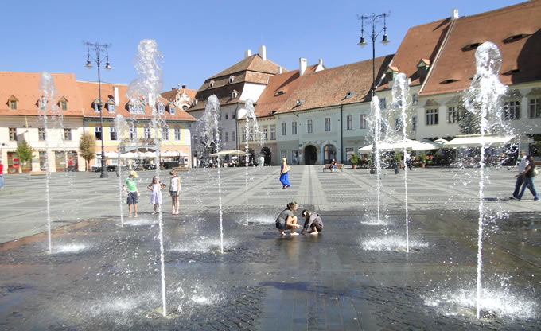
Sibiu Rural Area - General Information
Sibiu Town – EU Cultural Metropolis in 2007
              www.sibiu.ro

Slide 6
Sibiu Rural Area - General Information
Transfagarasan Road
  2011 Top Gear's best road in the world
  Connects the historical Romanian Regions Muntenia and Transilvania, acoross the Fagaras Mountains
  151 km, starts în Bascov (Muntenia Region) and ends to the crossroads with DN1 (Transilvania Region),
  Crosses the Fagaras Mountains at an altitude of 2042 m
  Contains : - 27 de viaducts and bridges
  - tunnel of 887 m length

Slide 7
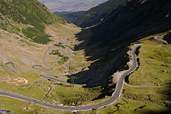
Sibiu Rural Area - General Information
Transfagarasan Road
    http://www.youtube.com/watch?v=XwMEX0jgPxE

Slide 8
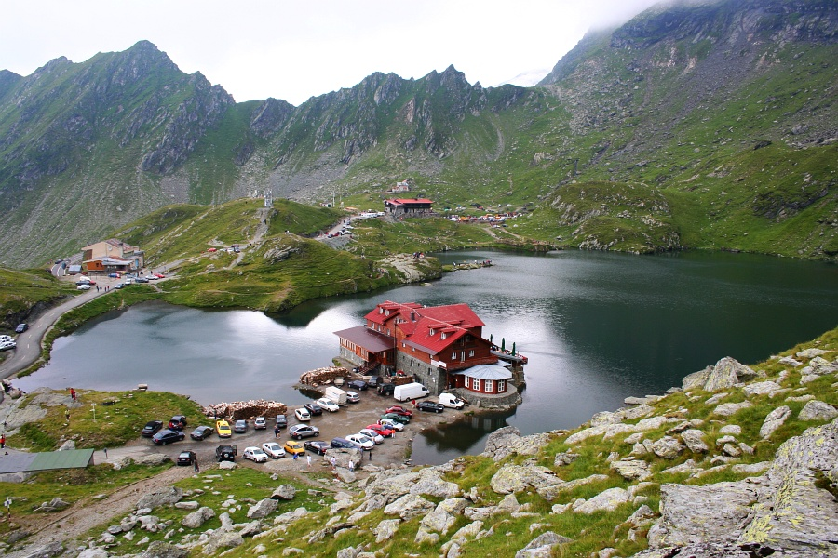
Transfagarasan Road
Balea Lake – 2040m
GPS – Balea Lac: 45.60335°N 24.61714°E
http://www.welcometoromania.ro/DN7c/DN7c_Lacul_Balea_r.htm

Slide 9
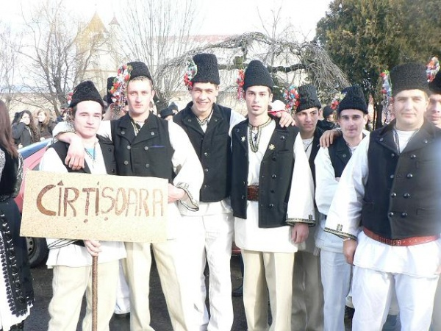
Sibiu Rural Area
Cartisoara Village - Oberkerz
In 2012, Cartisoara Village was included in the Official guide of “The most beautiful villages in Romania ”

Slide 10
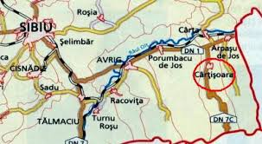
Sibiu Rural Area
Cartisoara Village
The first village placed on the Transfagarasan Road which crosses Fagaras Mountains from Muntenia to Transilvania Region
Distances: 50 km from Sibiu, 34 km from Fagaras and 20 km from Victoria city, on the Sibiu – Brasov National Road
Railway transport available
Altitude: 497M
Surface: 85,7 km²
1241 inhabitants

Slide 11
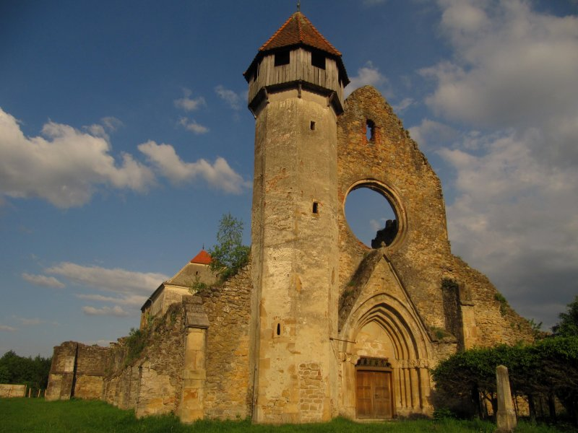
Sibiu Rural Area
Cartisoara Village
History
Since 1223

Slide 12
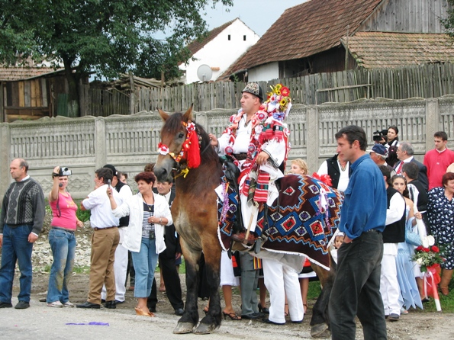
Sibiu Rural Area
Cartisoara Village
Tradition

Slide 13
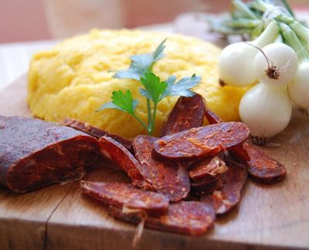
Sibiu Rural Area
Cartisoara Village
Tasty Food

Slide 14
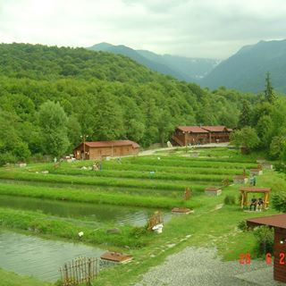
Sibiu Rural Area
Cartisoara Village
Trout farm in Albota

Slide 15
Sibiu Rural Area
Cartisoara Village
Opportunities for a healthy enjoyable holiday:
    Agrotourism – more than 20 guesthouses
    Festivals
    Traditional lifestyle
    Healthy food and life
    Variety of recreational activities - fishing, hiking, biking
    Direct access to mountain trips
    Still wild area in the proximity of the village

Slide 16
Sibiu Rural Area
Cartisoara Village
T h a n k y o u !
Gabriela CODREA
+40 722 145 004
codreagabriela@yahoo.com

